Slide 1

Social Media Marketing Strategy
03 June 2022

Slide 2


Marketing & DA co-op
Marketing
Content strategy
Partnership strategy
Engagement strategy
DA
Social Media Analysis
Posting Strategy
Engagement Strategy
Notes:
Responsible for the expansion of Lumnus’ social media presence, the marketing and data analytics teams collaborated to create in in depth analysis and solution.
The marketing team specifically created a project execution plan on the notions of….[give bulluted notes under “marketing”]
With the help of DA who did a in depth analysis on the Lumnus’ previous social media presence, as well as the best possible ways to optimize attraction.

Slide 3



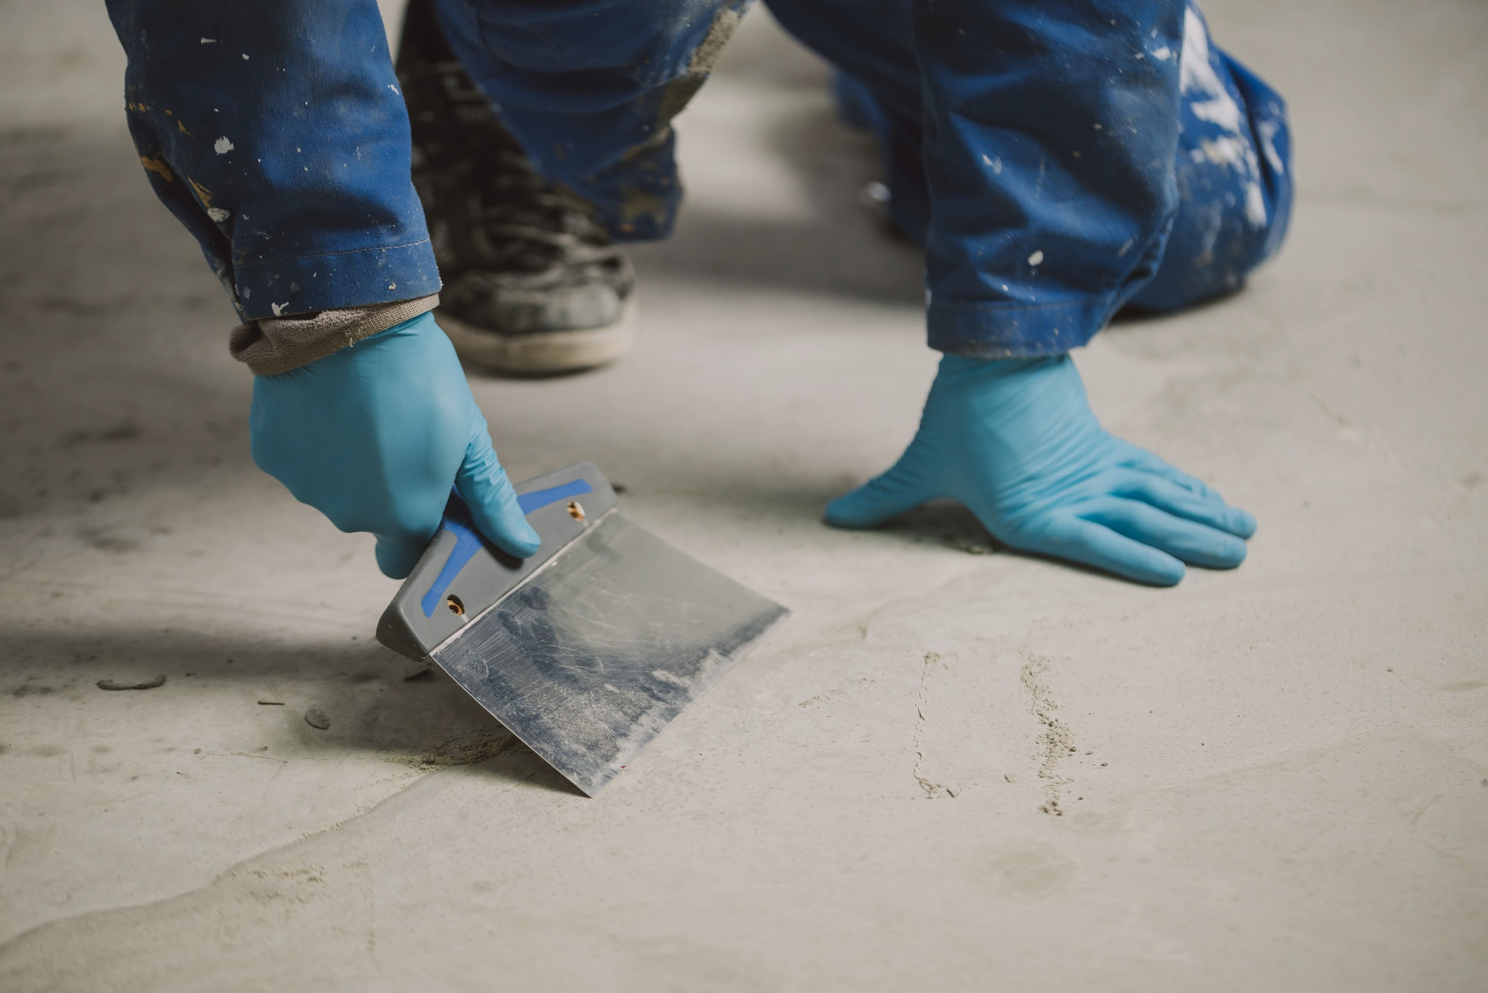
Project Execution Phases
Partnership Strategy
Content Strategy
Engagement Strategy
01
01
03
03
Collaborate with other organizations across campus to engage in partnerships.
02
02
Re-structure the bio to be reflective of our mission and allow for easy engagement. Promote stories that engage new members and potential clients.
Create lively and engaging content for the Instagram feed. Focus on bringing in more personality with members’ faces and achievements.
Notes:
Add some icons (pictures) —> more
The following execution phases as previously mentioned are….

Slide 4
What has and has not worked well in the past based on the data?
Notes:
In order to understand how Lumnus’ can maximize their social media presence/attraction we must first look at the past.

Slide 5
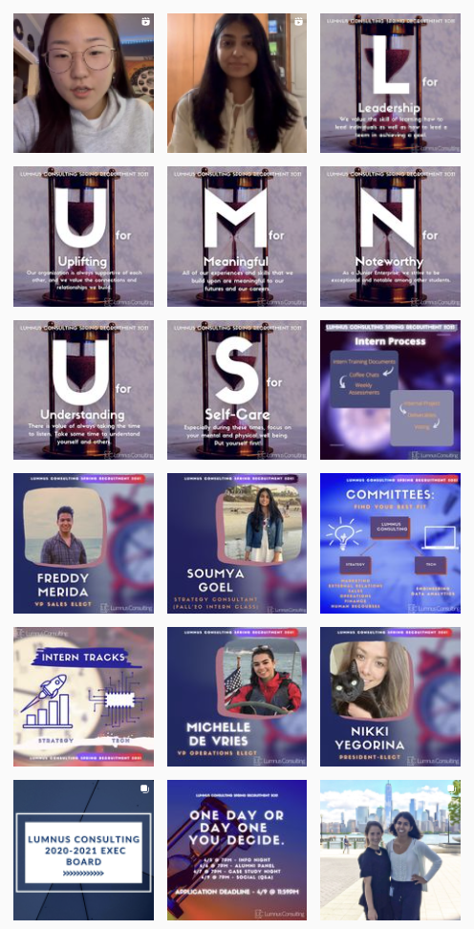
March 4, 2021 to June 6, 2021
Posts on the Lumnus Consulting Instagram page in this time period
Total Posts Made: 17
Total Followers Gained: 24
Theme: Purple, Red, Blue, Clocks/Hourglasses

Slide 6
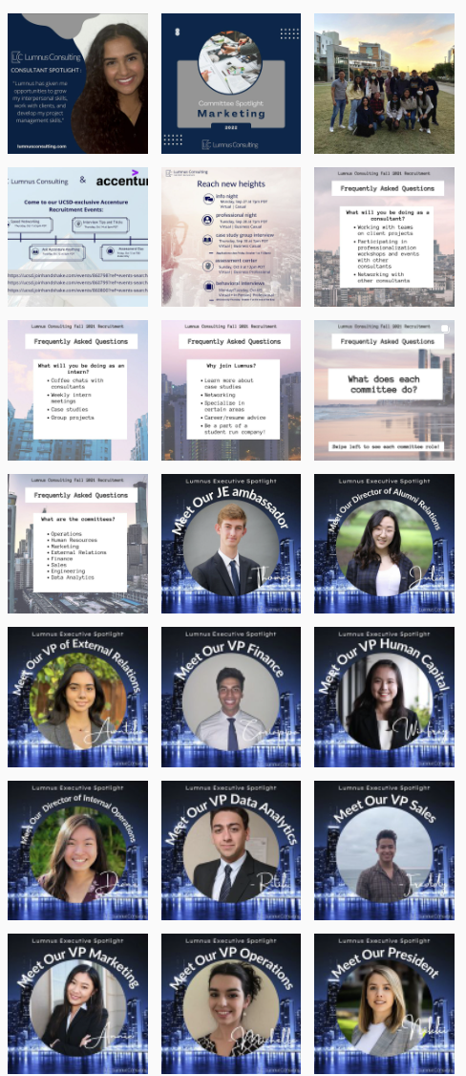
September 2, 2021 to November 28, 2021
Posts on the Lumnus Consulting Instagram page in this time period
Total Posts Made: 19
Total Followers Gained: 51
Theme: New York feel, skyscrapers, inconsistency in graphic art

Slide 7
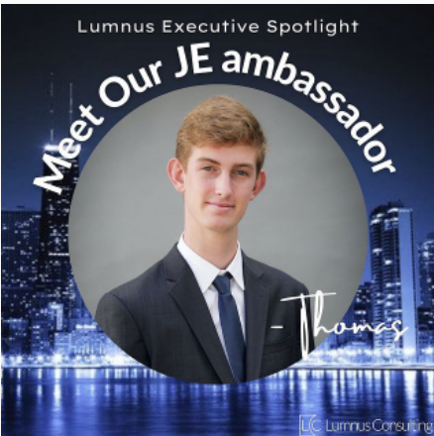
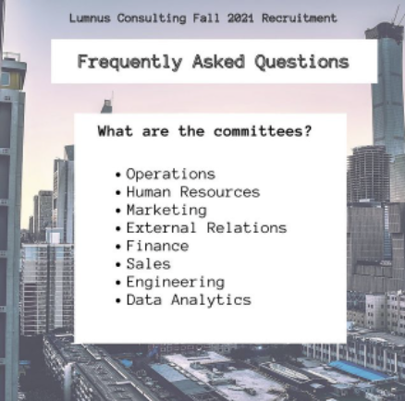
Inconsistent Theme

Slide 8
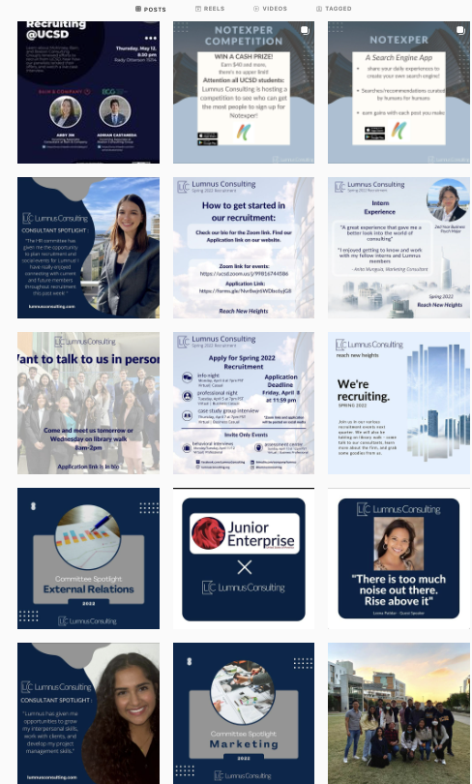

January 5, 2022 to May 14, 2022
Posts on the Lumnus Consulting Instagram page in this time period
Total Posts Made: 14
Total Followers Gained: 109
Theme: Navy and Light Blues, Sky, Skyscrapers, consistency
Color Palette Advised:

Slide 10
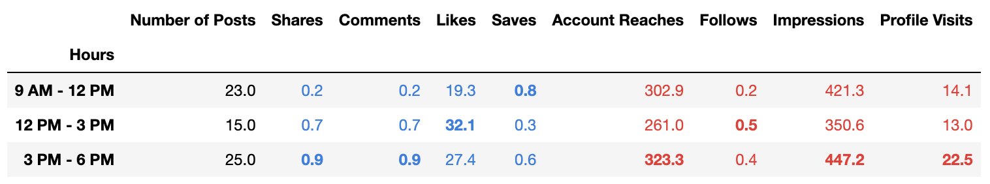
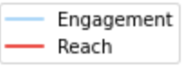
Average Engagement and Reach in a Day
01
Notes:
Arjun
Overall Comparison

Slide 11
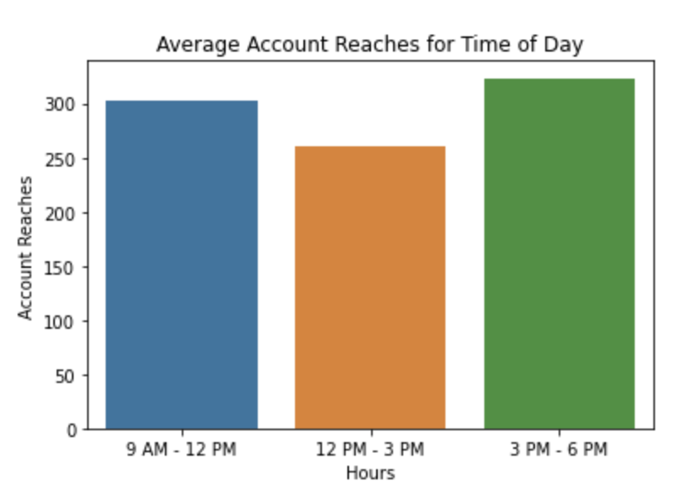
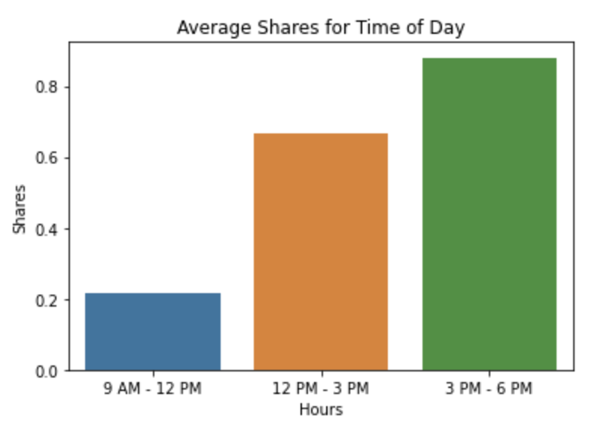
Comparing Reach and Engagement
01
Notes:
Arjun
Comparing Visually

Slide 12
Takeaway
3 PM - 6 PM: Best time to post overall
33% of Lumnus’ posts were posted in the late afternoon
Posting more during 3 PM - 6 PM can increase our reach and engagement!
01
Notes:
Arjun
Analyzing this data we have come to the conclusion that the best time to post is 3 - 6 PM

Slide 13
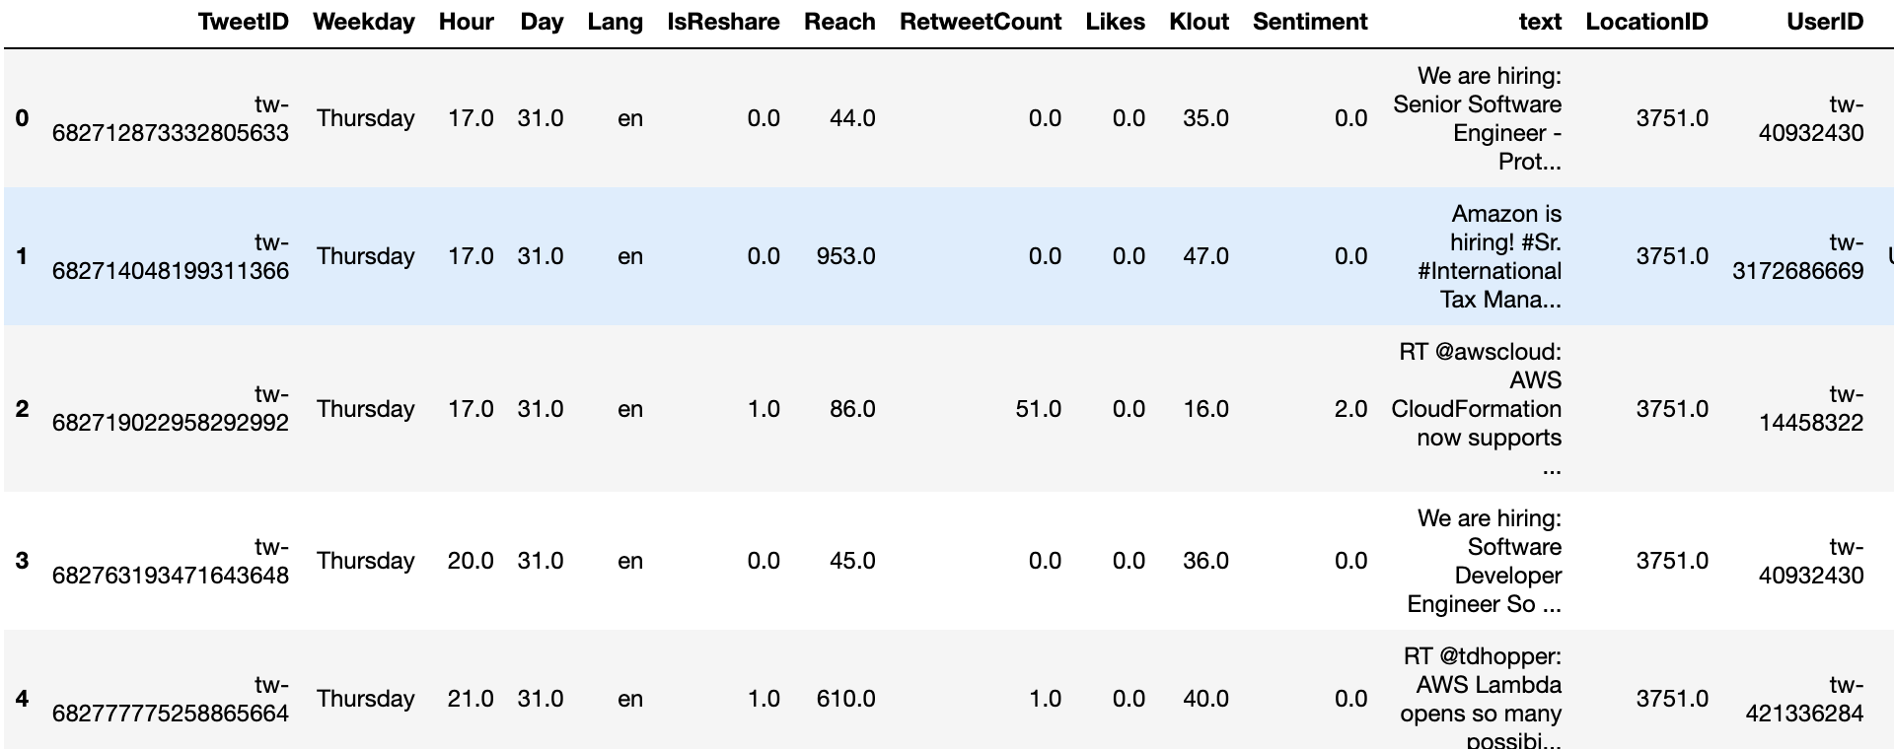
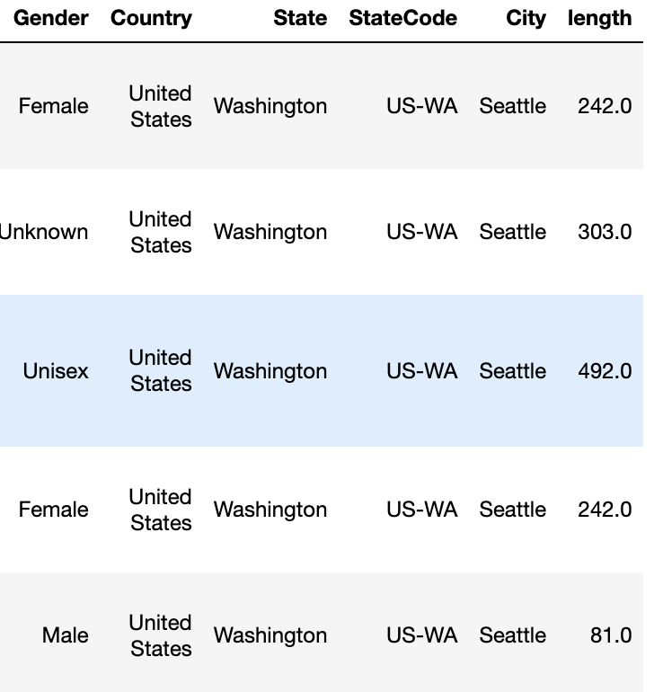
Best time of day to post
Part of 100,000 Twitter data
Notes:
In order to cross reference our conclusion on the previous slide we also gathered data from…

Slide 14
Why this data is a good choice?
Good API containing relevant features for our investigation
Large data and more information provide statistical significance and stability
The question I am trying to answer can be generalized no matter in which platform
We can hardly draw valid inference by applying Law of Large Number and other tools to the limited data we have about Lumnus and Instagram

Slide 15
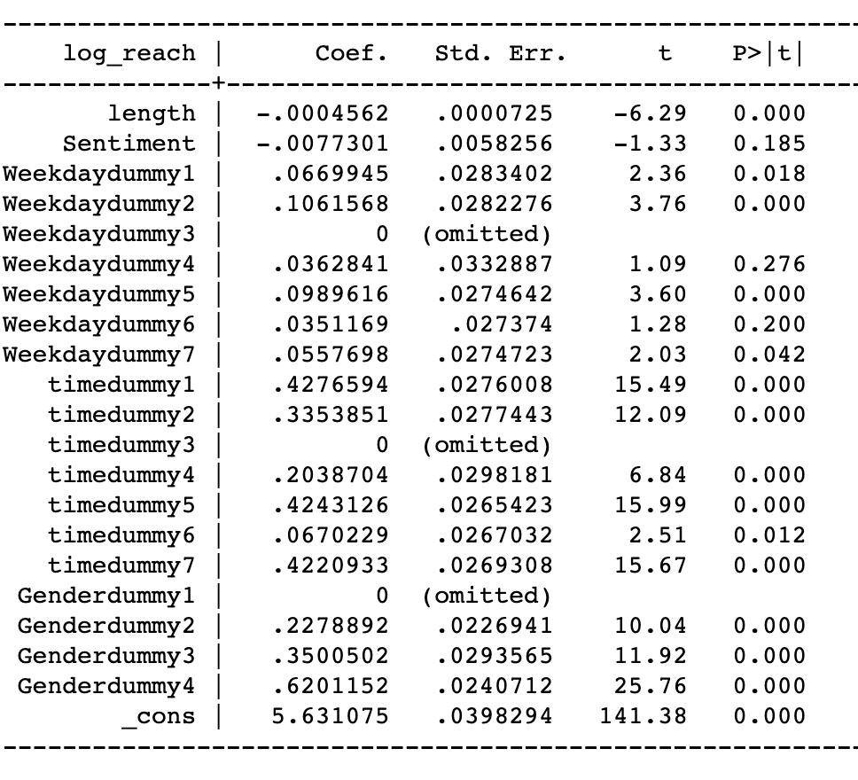
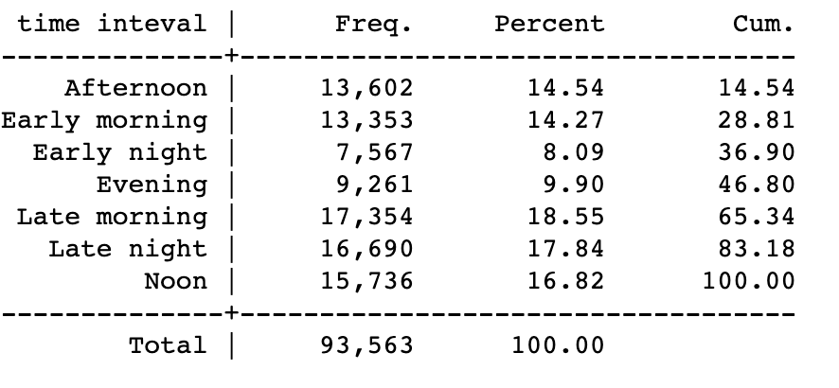
Regression and prediction
Afternoon
Early morning
Early night
Evening
Late morning
Late night
Noon

Slide 16
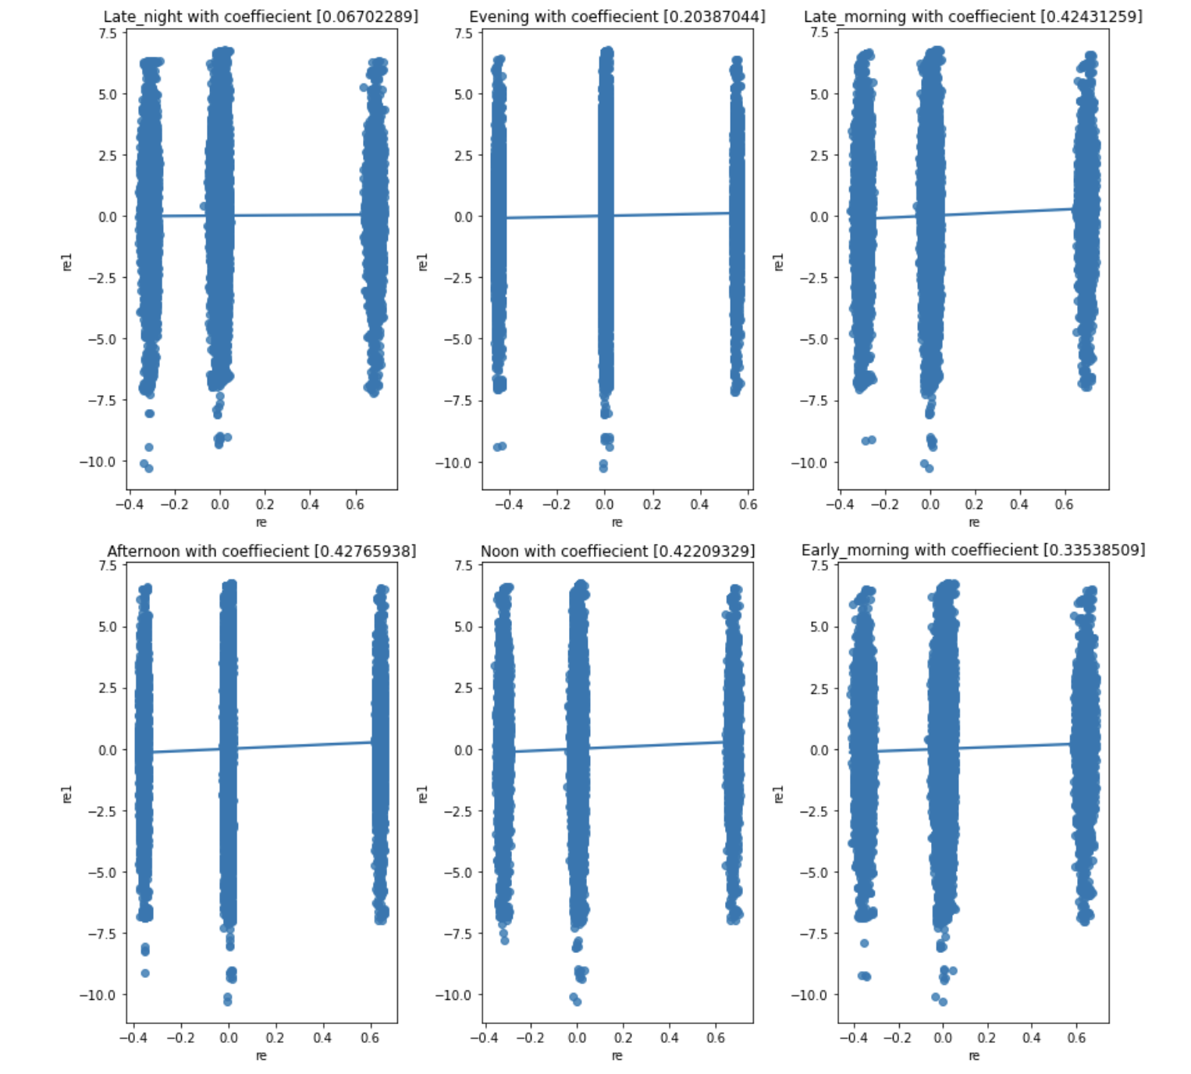
Frisch-Waugh regression

Slide 17
In the recruitment cycle of Spring 2022 we gained 100 new followers. Why is this? What does the data tell us?
Notes:
Taking the data previously mentioned in the previous slides, in the recent year (2022) Lumnus was able to gain 100 new followers…why is this?

Slide 18
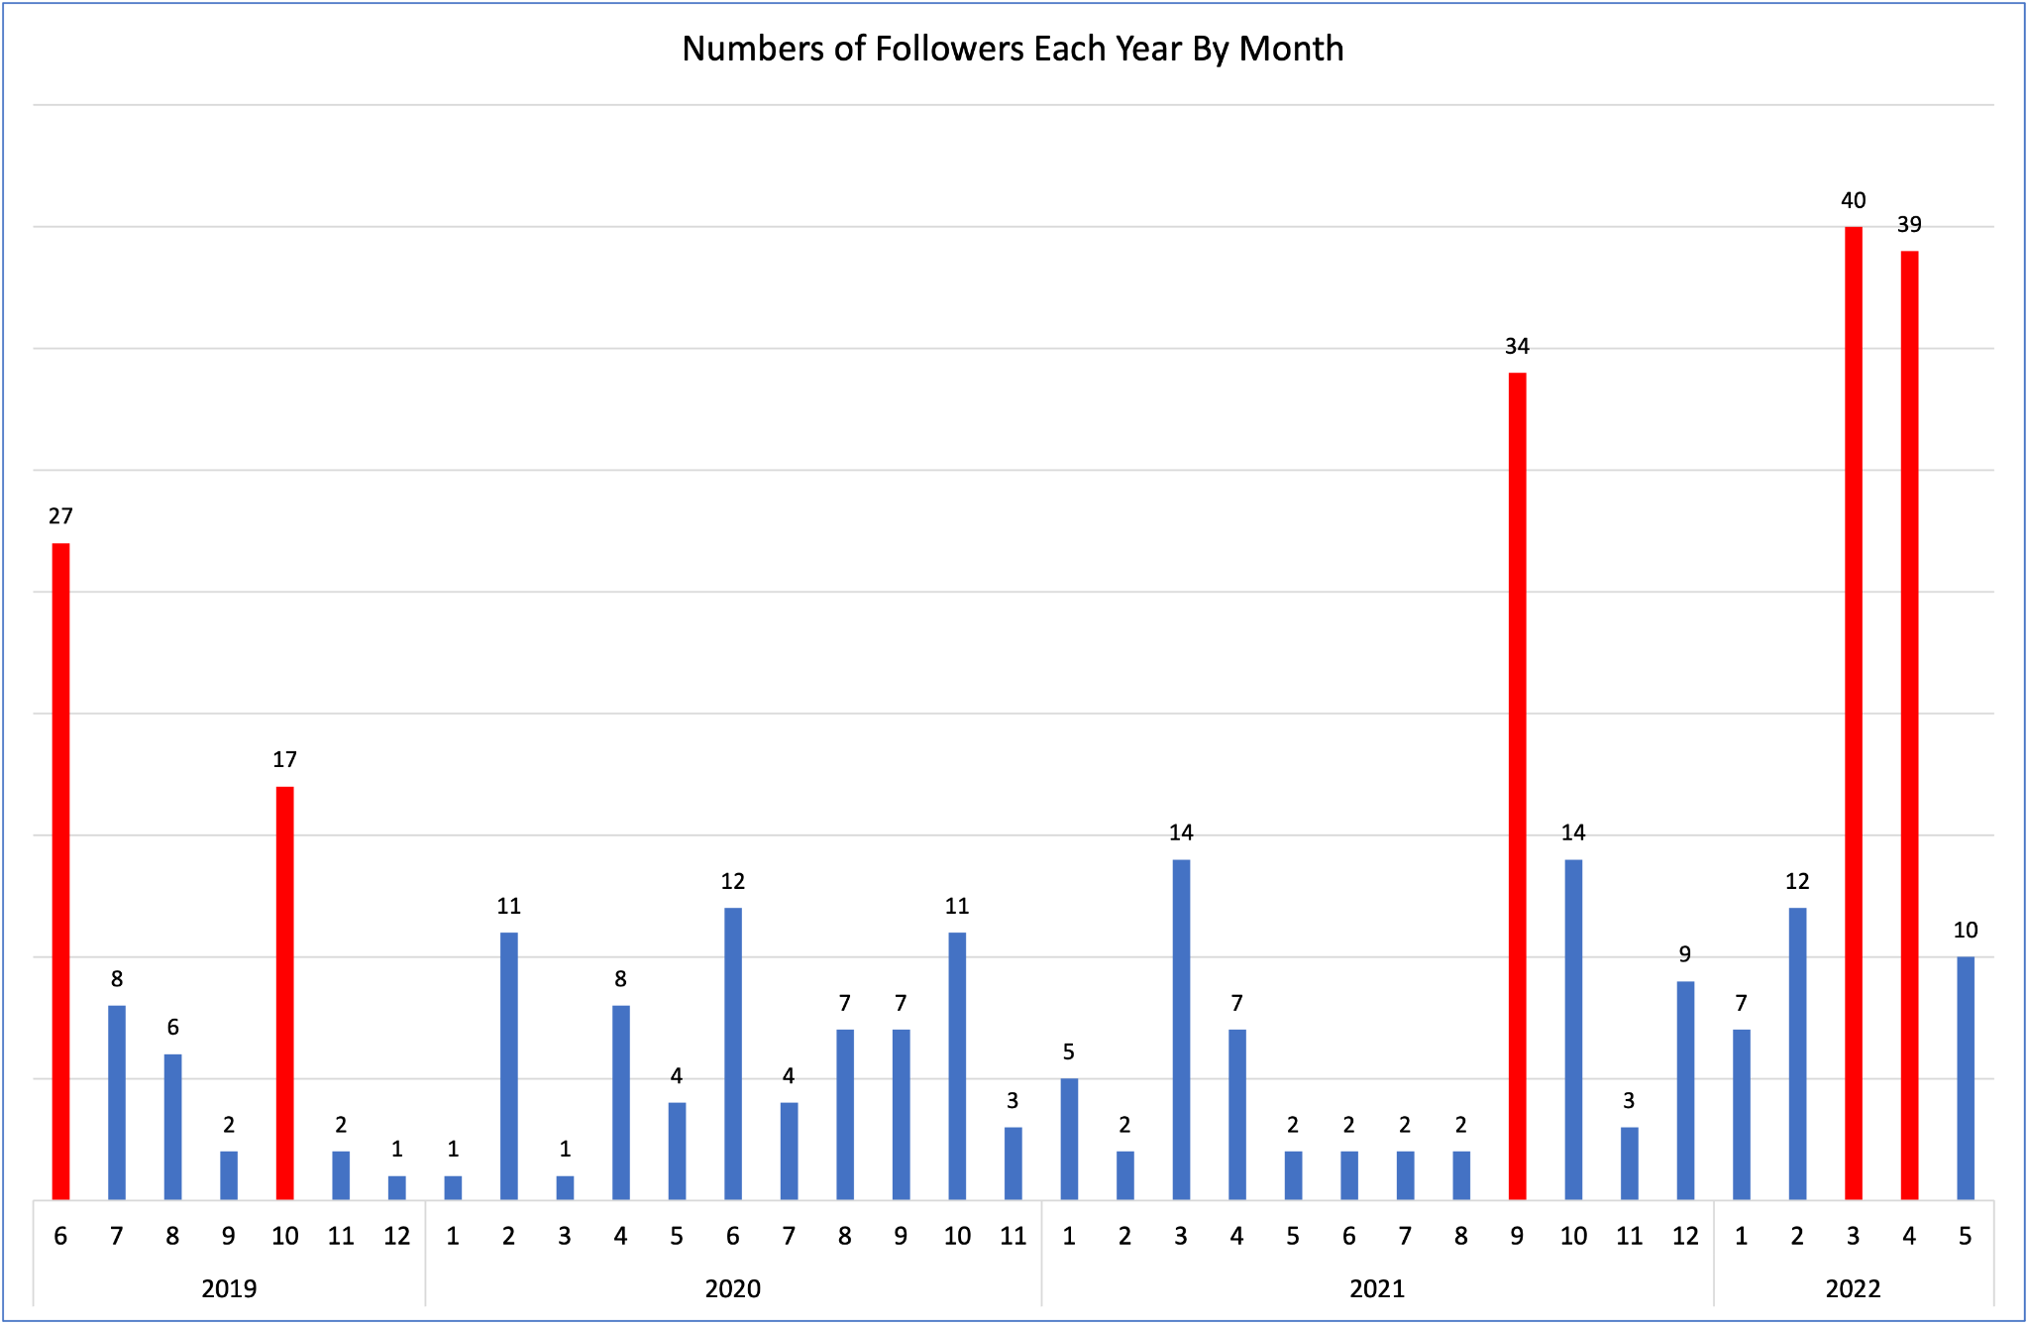
Why did we gain 100 new followers spring 2022
Recruitment Seasons in Fall & Spring
Has not gained many followers apart from recruitment season
Notes:
In 2022, Lumnus Consulting has gained the most followers in March with 40 followers and April with 39 followers. There is also a significant increase in followers in September 2021. These increases in followers are attributed to recruitment season in Fall and Spring. During these two cycles, Lumnus Consulting usually increases their publicity in UCSD by posting frequently on social media and hosting in person/ online recruiting events. This column chart also indicates that apart from recruiting seasons, Lummus consulting has not gained many followers.

Slide 19

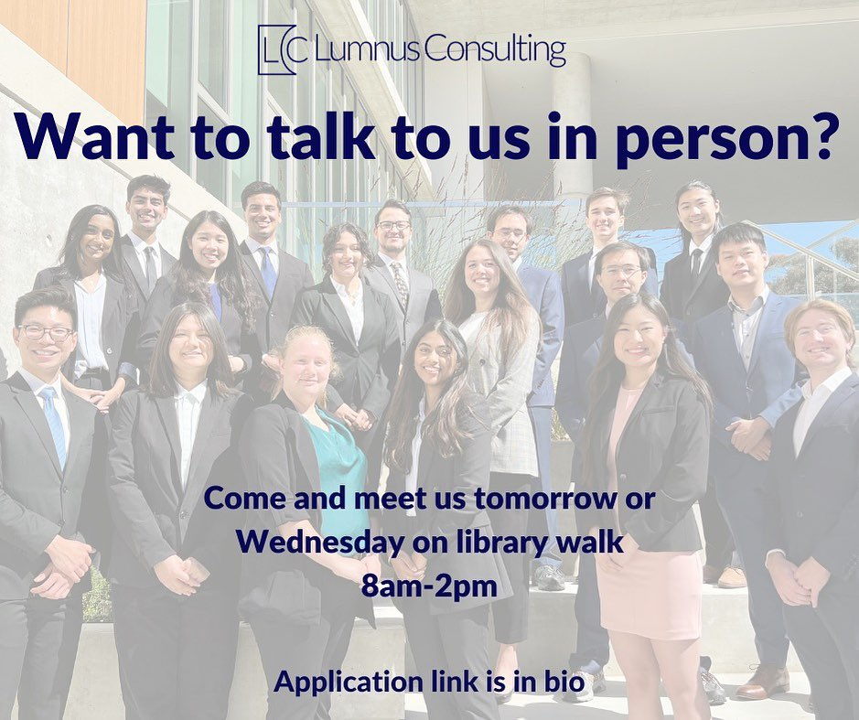
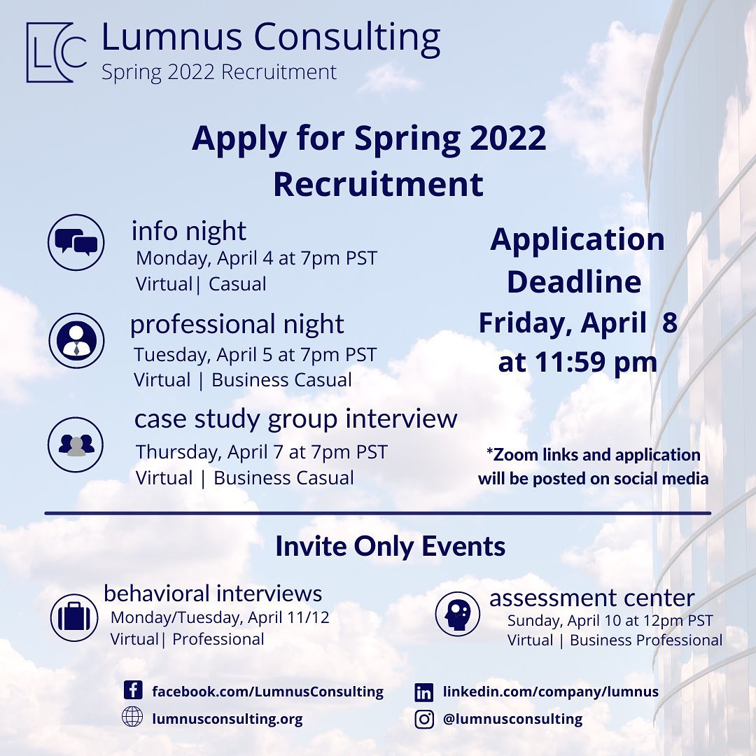
External Factors
Students-to-students promotion
Return back to in-person mode
Spring 2022 recruitment posts on March 27th
In-person library walk dissemination on March 29th
Own brand logo in late 2021/ stronger image of professionalism
Notes:
We’ve also considered some external factors that may cause the increase in followers in 2022. One major reason is that in Fall and Winter, school returns to in-person mode, which is highly likely why there are more student engagement in Lumnus activities. On top of that, on March 27th and 29th, there is also Spring recruitment and in-person library walk dissemination that increase the publicity of Lumnus in UCSD. We think that increasing student-to-student promotion of Lumnus is a significant factor that spur the increase of followers in March and April 2022. We also discovered that Lumnus has incorporated a brand logo which creates a strong image of professionalism starting from late 2021.

Slide 20
Knowing and seeing this data what should Lumnus do? What should Lumnus be posting on social media to target new recruits and potential clients?
Notes:
Now that we have done an in depth overview of Lumnus’ past, this is the course of action we pose to you in order to target new recruits and potential clientele

Slide 21
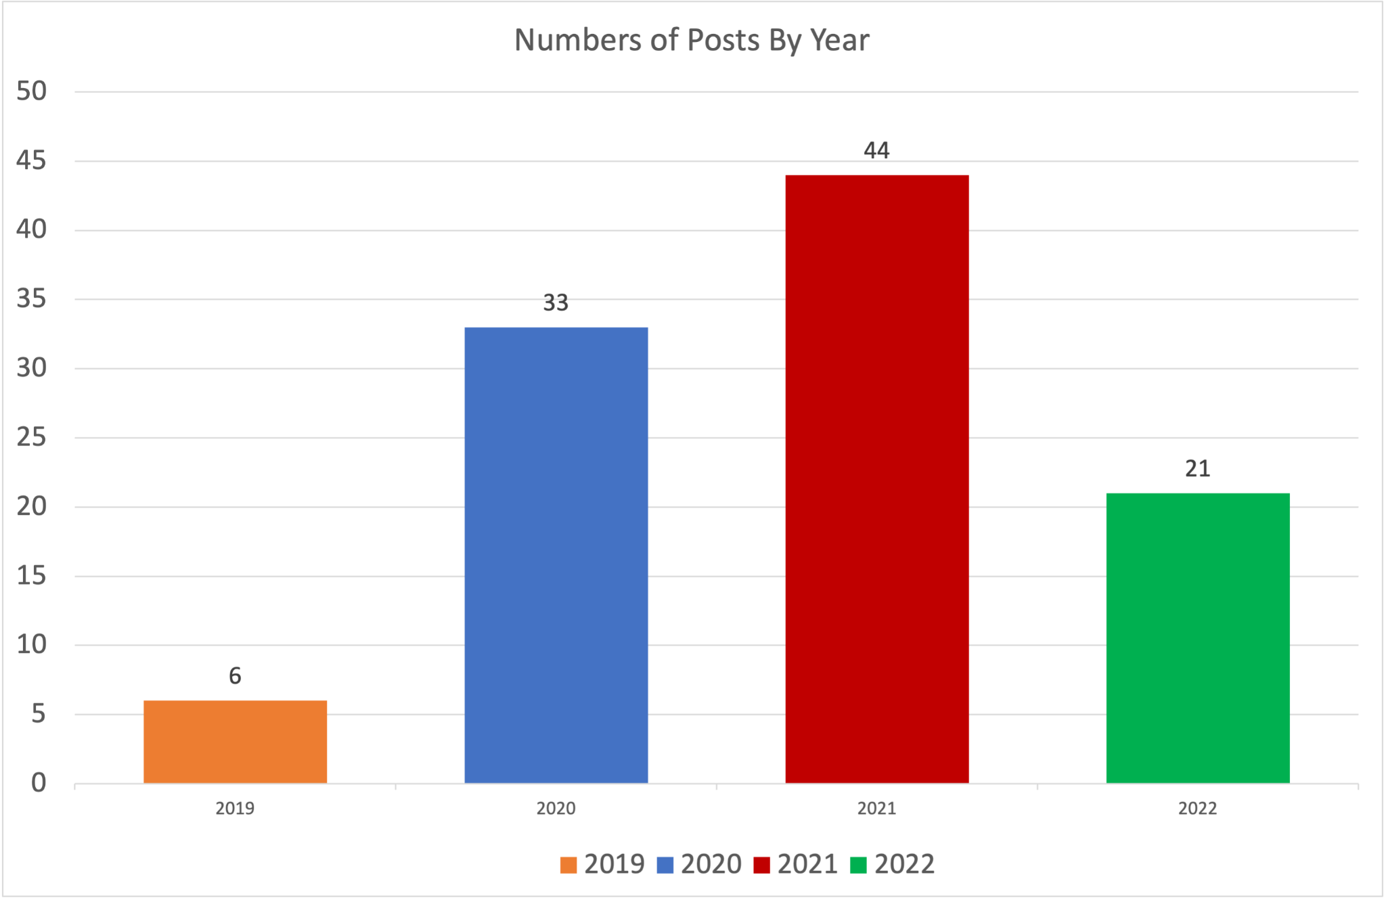
Frequency in posts
44 posts on Instagram in 2021
A total of 21 posts on Instagram in 2022
Fewer posts during non-recruiting seasons
A total of 65 posts from 2021-2022 in comparison to 39 posts from 2019-2020
Notes:
In observing the data of posts on Instagram, we’ve discovered that frequency in posts is a key factor in attracting followers. There are 19 posts in September 2021, which entails introduction to new board members, descriptions of each committee in Lummus, and Fall recruitment timeline. There were also around 5 posts in March and April of 2022. However, apart from recruiting seasons, there are less posts in the other months within a year. There are also more posts in 2021-2022 than other years.

Slide 22
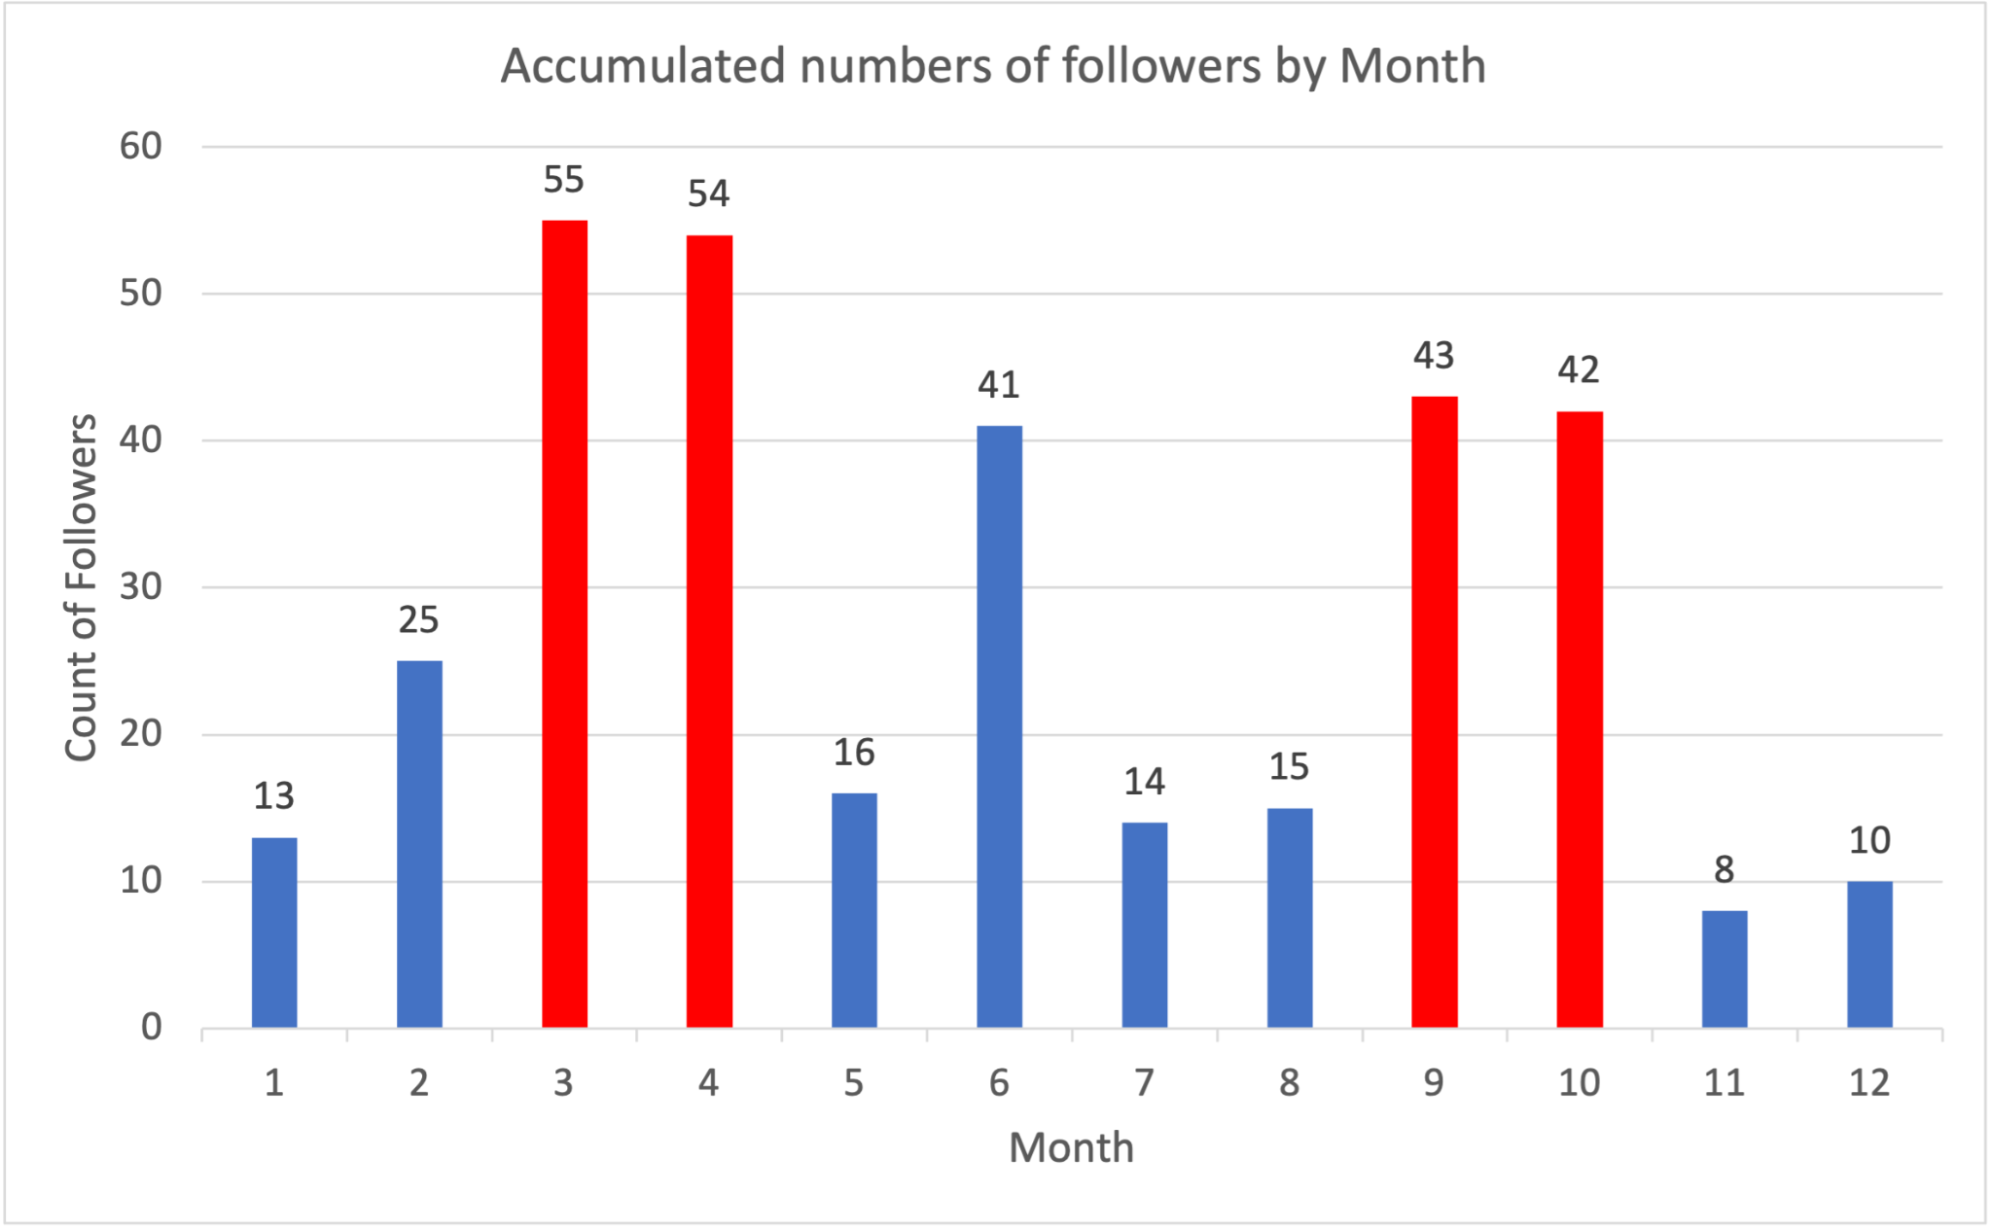
Total count of followers per month graph
Gains of followers attributed to frequency of posts
Notes:
This is a visual representation of total count of followers per month. The column chart visually displays that Lummus gains most of its followers in September with 43 followers, October with 42 followers, March with 55 followers, and April with 54 followers. These gain in followers are attributed to frequency in posts, but as we implement parts of the content strategy, we will start to see an increase in our target audience.

Slide 23
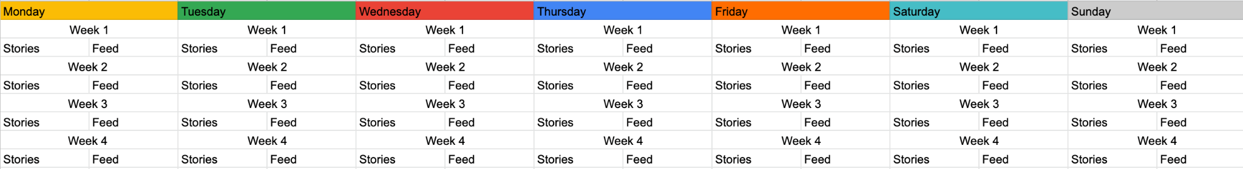
Content Strategy - Amount of Content
Idea: Pushing out regular content
Retain and boost engagement with current followers
Maximize opportunities to gain new followers
Problem: need lots of content to post
Solution: detailed, premeditated content calendar
From DA: what to post, what day to post, when to post
Distribute posts throughout 10 weeks
Notes:
Split up into more slides
balance b/w minimal slides content and explanation
Key pts
First, we want to touch base on the first part of our project execution phase — content strategy….

Slide 24
Content Strategy - Amount of Content
Potential types of posts to include in content calendar:
Recruitment + intern process
Interviews with most recent intern class about experience of intern process
Interviews with directors about experience leading intern proces
Past projects
Piquing followers interests in potential projects may result in decision to apply
Events + socials
Creates image that Lumnus fosters personal relationships
Member + alumni spotlights
Lumnus already does this on their instagram
Upping quantity will lead to online presence, diversification, and personality
Notes:
Split up into more slides
balance b/w minimal slides content and explanation
Key pts
So to sum up our content strategy ….

Slide 25
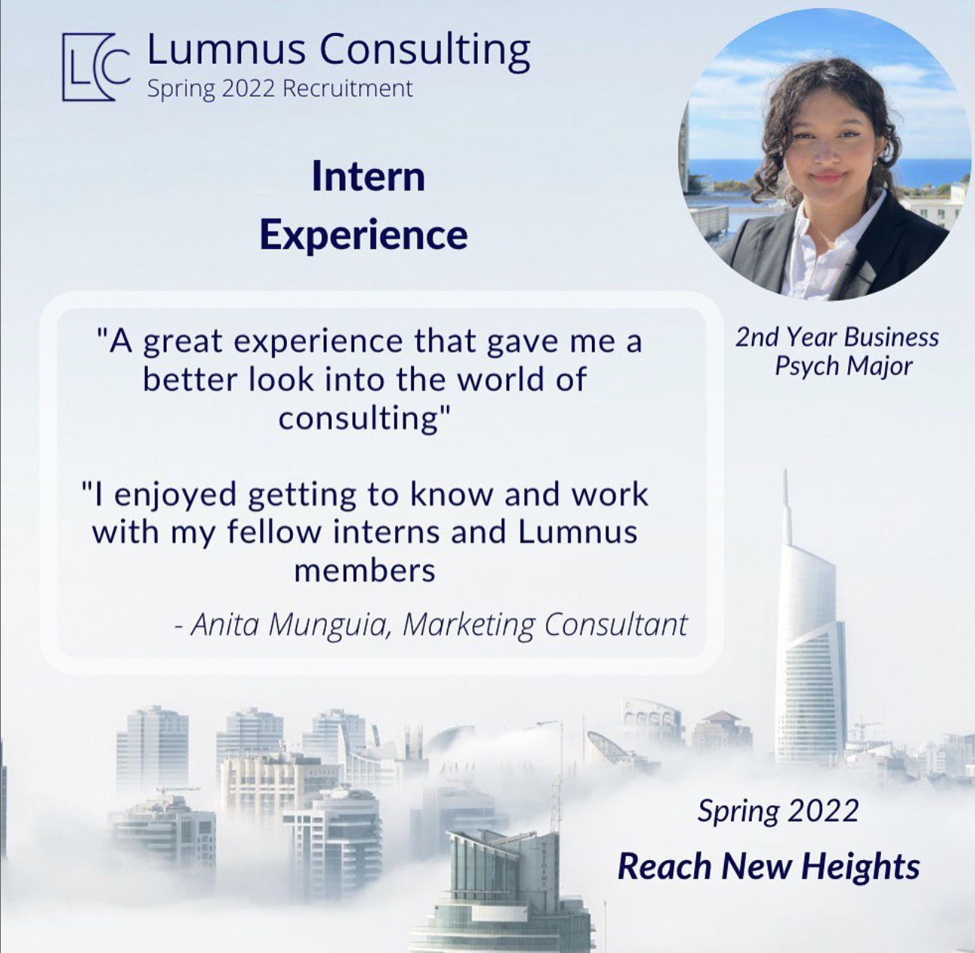
Content Strategy - Structure of Content

Slide 26
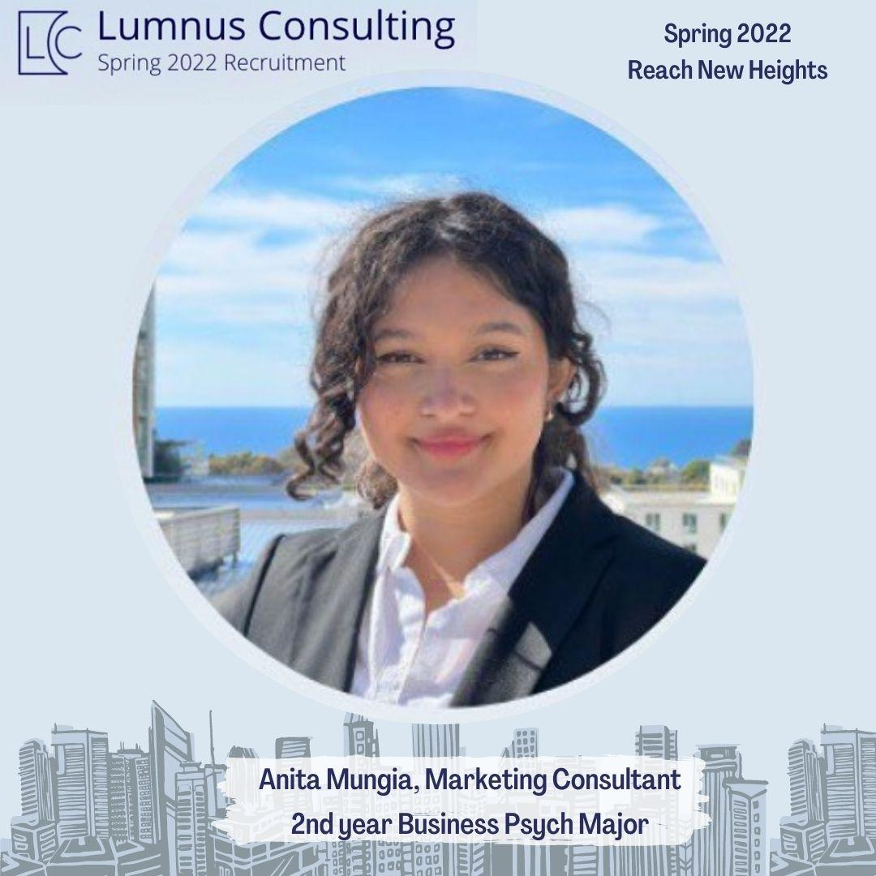
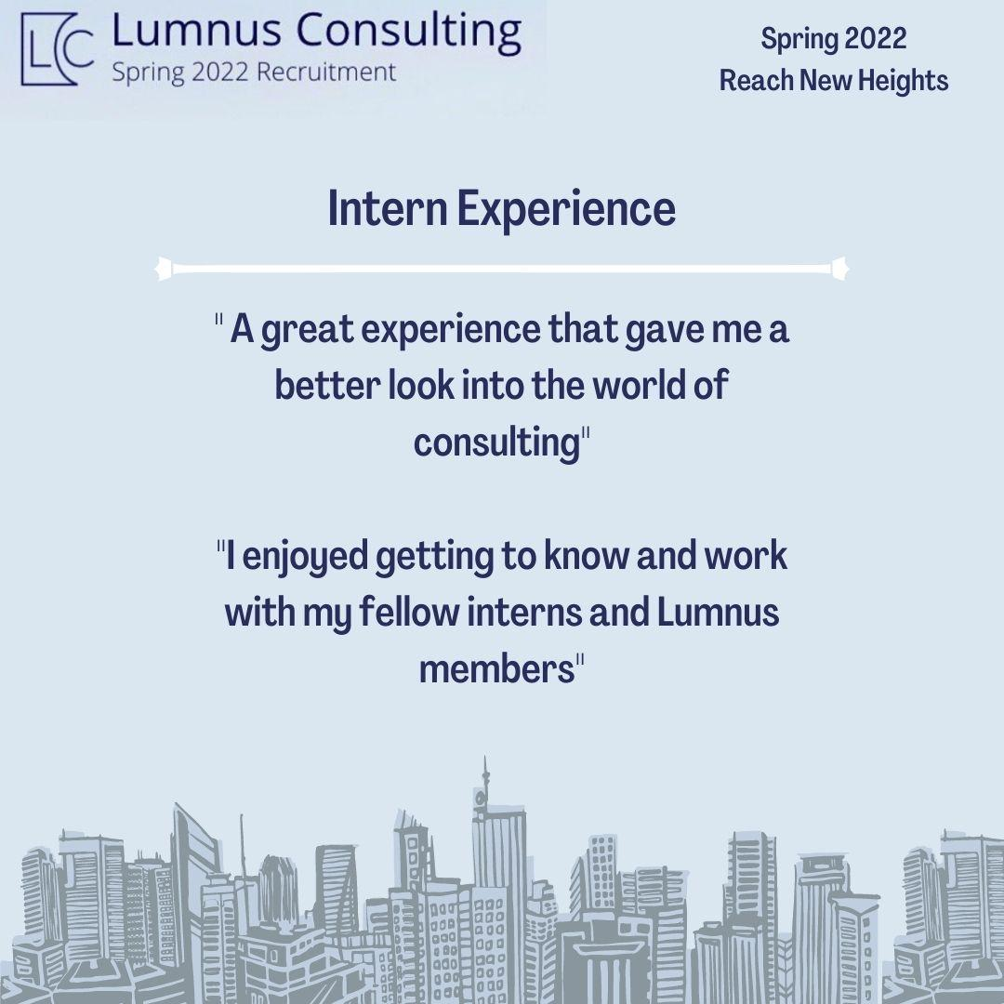
Content Strategy - Structure of Content

Slide 27
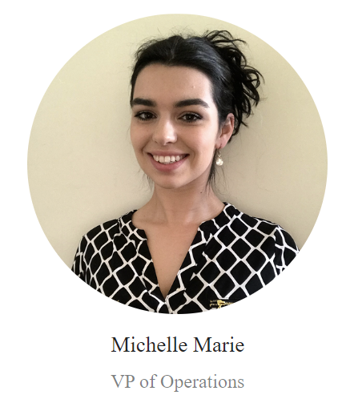

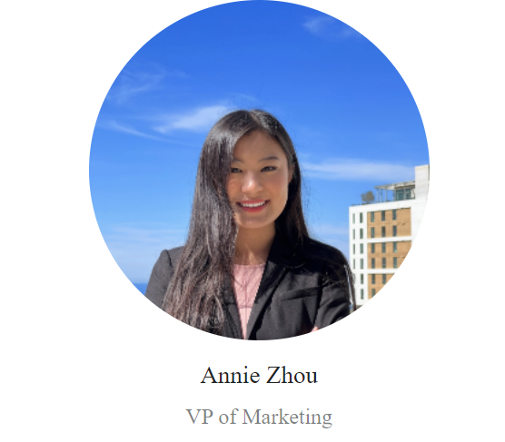
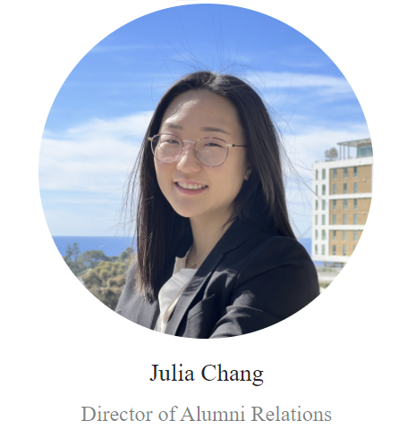
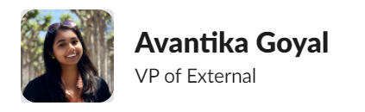
Partnership Strategy
Main Idea
Optimizing social media presence (indirect outsourcing)
Innovative and creative outlook (digital presence)
Increase in attraction/engagement/recruitment
Word of mouth marketing
Potential Clientele acquisition
Co-ops / joint ventures
Committee & Command Chain
Marketing & External
VP of Operations
VP of both tracks
Work With US
Notes:
Now as or second stage in our project execution — partnership strategy

Slide 28







Partnership Strategy
Engineering / ACM / Women in STEM / Grad societies / Rady Clubs / Pre-professional & Developmental orgs
Notes:
Engineering = “Management & Engineering consulting”
ACM = helps DA track through tech workshops, ACM innovate = entrepreneurship
Women in STEM = increase university rates as well as demographic of women in business
Grad societes = increase clientele acquisition
Rady clubs = “adwave” —> Competitive marketing competition and Cogsci for innovate thinking
Pre-professional = leadership development and professional growth (for PM’s)

Slide 29
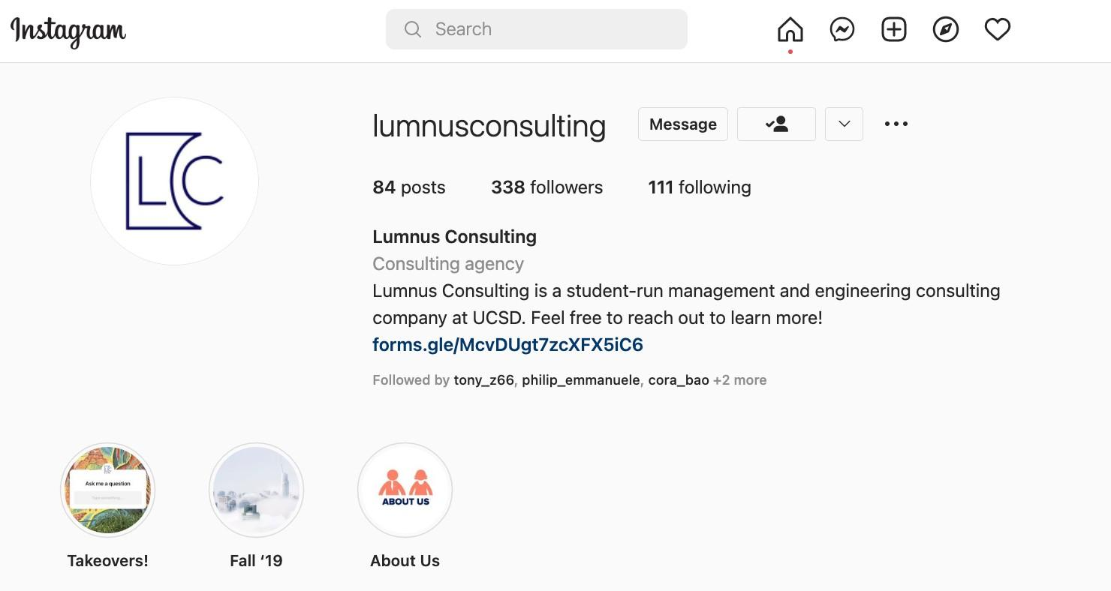
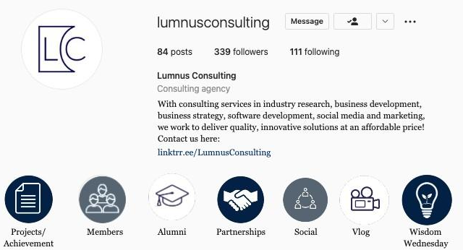
Engagement Strategy
Instagram Bio & Theme
Mission statement refinement
External Links and Contact
Cohesive Theme: Color Scheme
Updated and Relevant Content
Notes:
Next, we’ll delve into the highlight content and our final project execution phase — engagement strategy

Slide 30







Engagement Strategy
Instagram Highlights
Projects & Achievements
Statistics, deliverables, potential clients
Our Members
Spotlights for all new + executive team members
Alumni
What they’re doing now, impact on career
Partnerships
Casual, genuine, content with other orgs
Social
Casual, show connections
Vlog
“Ask me anything” + Instagram takeovers
Wisdom Wednesday
Older members sharing advice with younger members
Notes:
Vlog - currently have takeovers but theyre very old and not done on a consistent basis, should continue
Keep layout nice fashion (even spacing)

Slide 31
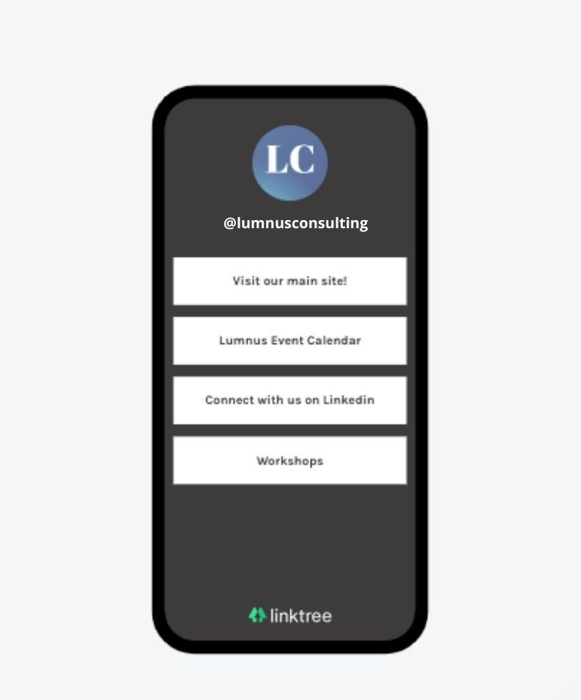
Engagement Strategy
Streamlining our Social Media
Mission statement
Including a set linktree on all platforms
Main site link, event calendar, recruitment, talks, linkedin etc.
Increases:
Accessibility
User engagement
Student curiosity
Notes:
Alexa

Slide 32

Summary
Updated Social Media & Content
New recruits & Current Member Retention
Increased Accessibility and Engagement
Notes:
Muskaan

Slide 33
Thank You
Notes:
Deliverables: https://docs.google.com/document/d/1bvv4ReeJ12YxIeU-YVeNabxqcTCdW2U75MGxQRJm_hU/edit?usp=sharing

